Slide 1
Biomedical Serious Game System for Lower Limb Motor Rehabilitation of Hemiparetic Stroke Patients
2020 IEEE Transactions on Neural Systems and Rehabilitation Engineering

Slide 2
Introduction
1. Paresis（轻度瘫痪）is one of the most disabling and prevalent disorders in stroke victims.
2. It is clear that the rehabilitation exercises can improve functional skills even a
few years after the stroke event.
3. American Heart Association / American Stroke Association recommendations
emphasize the importance of physical activity for stroke survivors.
4. The big challenge in rehabilitation is to make the process more motivating for the
patient. In this sense, videogames are an alternative method for engaging post-stroke subjects in the rehabilitation process.
5. However, commercial games are not developed for rehabilitation, but for entertainment of healthy people, which limits their therapeutic application.

Slide 3
Introduction
6. This paper presents a biomedical SG based on muscular strength for motor rehabilitation of the lower limb in hemiparetic patients’ post-stroke.
7. Objectives of this study :
(1) To evaluate the therapeutic efficacy of the proposed biomedical SG.
(2) To investigate game metric properties for clinical evaluation of the patient’s motor recovery.

Slide 4
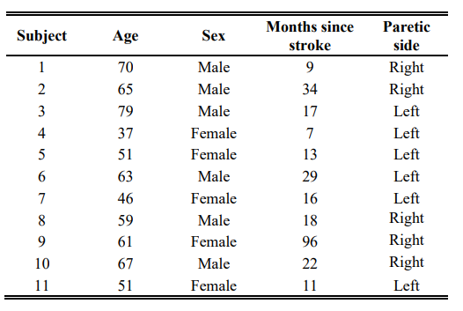
Materials and methods
1. Participants
(1) Inclusion criteria: chronic hemiparesis for stroke, >= 18 year old, ability to walk independently using a walking aid.
(2) Exclusion criteria: hemiplegic patients, patients with severe visual and/or auditory impairment, sensory aphasia and cognitive deficit.

Slide 5
Materials and methods
2. Measure assessment
(1) Motor recovery: E section of the Fugl-Meyer Assessment Lower Extremity scale (FMA-LE).
(2) Functional mobility: Timed Up and Go test (TUG).
(3) Gait speed: 10-meter Walk Test (10-MWT).
(4) Participants were tested for motor recovery, balance and physical mobility, functional mobility, strength of the paretic’s quadriceps femoral muscle group
(QFG) and strength of the paretic’s hamstring muscle group (HSG).
3. Procedure
(1) The patients were submitted to a treatment period using the SG for 10 weeks, having two sessions a week on alternate days (total of 20 sessions).
(2) Each session was composed of three sets of two minutes with a one-minute break between each other.

Slide 6
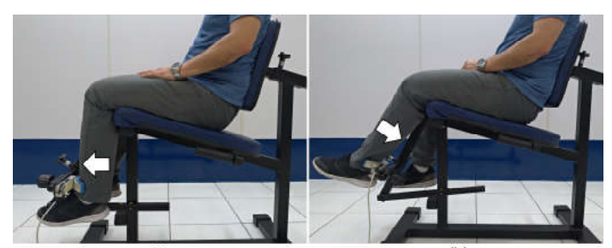
Materials and methods
4. The serious game
(1) The visual aspects of the game are simple and focus the patient to hit the ball using the paretic leg.
(2) Game parameters that can be changed included: racquet size, ball size, ball speed and color elements.
(3) All patients perform a Maximum Voluntary Isometric Contraction (MVIC，最大随意等长收缩) with their muscle group for five seconds.The strength peak
value is used as a reference for the SG.

Slide 7
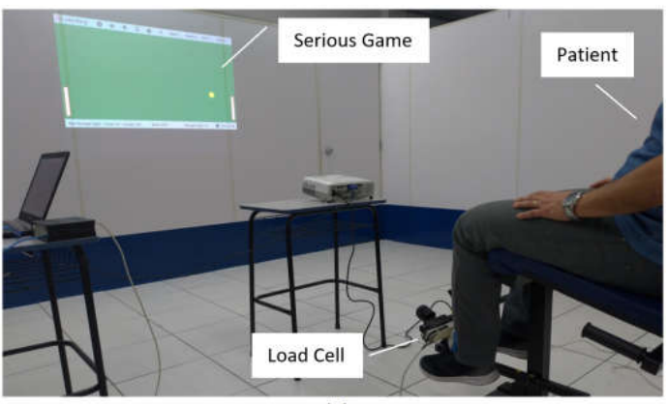
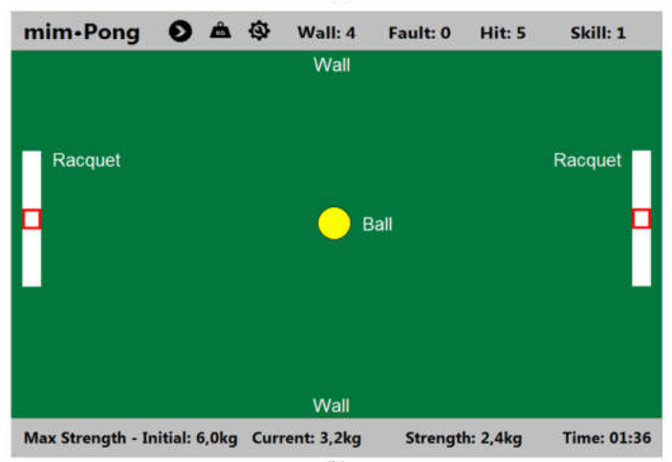

Slide 8
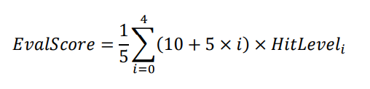
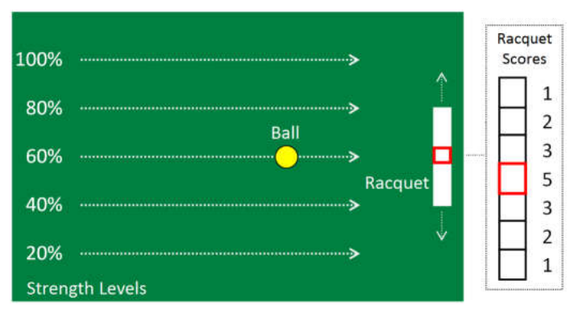
Materials and methods
5. Assessment protocol
(1) At level 0, the patient should produce strength equivalent to 20% MVIC in order to hit the ball in the racquet center.Respectively, levels 1 to 4 represent of 40, 60, 80 and 100% of the MVIC.
(2) The patient’s performance (EvalScore) is calculated according to equation:

Slide 9
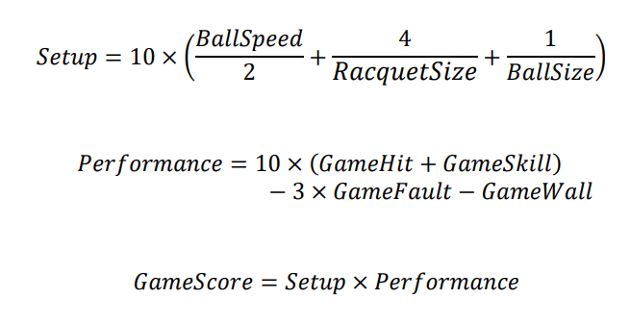
Materials and methods
6. Performance assessment while training

Slide 10
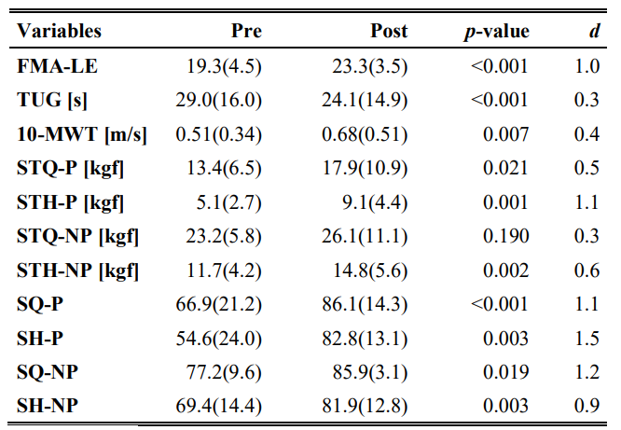
Results
1. Results of the pre/post-intervention.

Slide 11
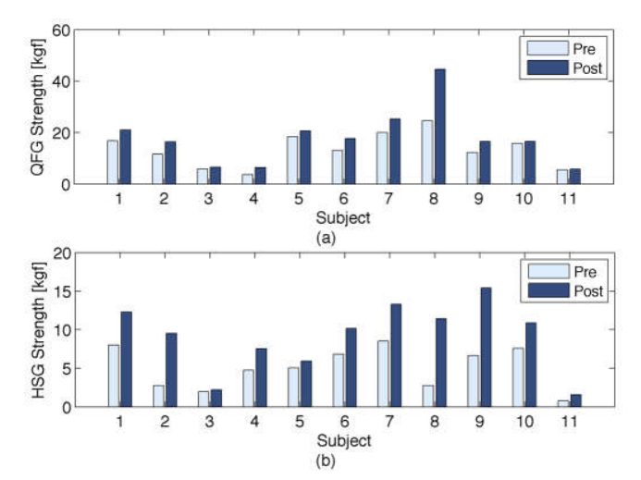
Results
2. Results of QFG and HSG.
(1) A muscle strength increase was observed in all measured muscular groups.
(2) The strength difference between the paretic and non-paretic sides of the QGF and HSG decreased.

Slide 12
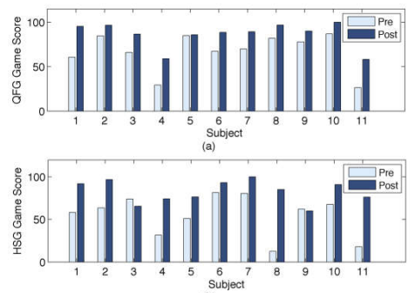
Results
2. Results of QFG and HSG.
(3) A significant difference (p<0.001) was obtained in the training phase assessed by the GameSkill variable.

Slide 13
Discussion
1. For the paretic side, the effect size was medium for the QFG muscular strength (d=0.5; p=0.021) and large for the HSG muscular strength (d=1.1; p=0.001).
2. Although not trained, the strength of the non-paretic side was also increased after the intervention.
3. The strength asymmetry between the paretic and the non-paretic sides was reduced for both muscular groups after intervention.
4. Results obtained in our study showed improvement in gait speed (d=0.4; p=0.007).
5. A large effect size of 1.0 (p<0.001) was observed in the motor impairment reduction assessed by the FMA-LE.
6. Correlations between FMAS-LE and game score is an important finding of this study.
7. Limitations: control group and small sample size.

Slide 14
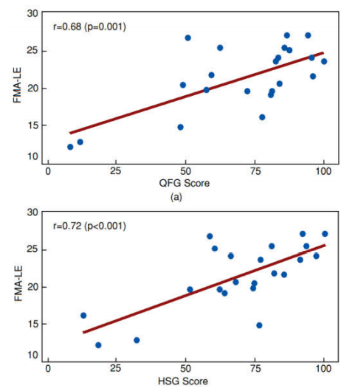

Slide 15
Conclusion
1. The clinical results showed that the treatment was beneficial for the patients.
2. Correlations between the game score and the clinical tests indicate that the game metrics accurately correspond to clinical outcome.

